Slide 1
Flipping Tutoring: Using Technology to Innovate a Drop-in Program
Justine Chasmar, Academic Coordinator
Katie Hafner, Graduate Assistant
Academic Success Center, Clemson University

Slide 2
Learning Objectives
Participants will be able to…
Utilize smart pen technology.
Create training modules for peer-leaders on recording problem solving sessions.
Implement a model for creating an online repository of recording problems and study skill guides.
Notes:
Katie

Slide 3
Overview
Institution and Program
Creation
Why did we start the project?
What is it?
Implementation
What is it?
How do we implement the program?
Adaptation
What are the pro’s and con’s?
How can this project address your needs?
Notes:
Katie

Slide 4
Clemson, the ASC, and Tutoring

Slide 5
Clemson University
Land Grant Institution
Foothills of SC
Student body
Colleges
Majors
Retention/Graduation Rates
Notes:
Katie
16,562 Undergraduate
4,206 Graduate
5 Colleges
Agriculture, Forestry and Life Sciences
Engineering and Science
Architecture, Arts and Humanities
Health, Education and Human Development
Business and Behavioral Science
70+ UG majors
100+ G degrees
Retention Rate
91.3% FTFT
Probation Rate
7.5% FTFT
18.7% Transfer

Slide 6
Academic Success Center
Establishment
History
Growth
Services
Partnerships
Notes:
Katie
-Established in 2001
-Academic Support Center
-Pilot programs: tutoring, SI
-Goal: help Clemson students stay in school and retain scholarships
-Staff: admin, program coordinator, ac counselor, temporary Director, professor emeritus
-Started in Brackett hall
-June 2002, Moved to Cooper, hired Dr. Richardson
-moved to library
-new director, Dr. Richardson
-added CU 101
-additional staff
-2003
-name change: SUCCESS
-moved from Student affairs to Academic affairs
-some piloted programs moved to Undergrad Studies: Freshman Academic Progress Program (early alert), Summer Reading Program, and Transfer Academic Programs
-2009, SDS moved from under ASC to separate unit
-2012, new building opened
-Current Staff: the center director, three program coordinators, two academic coaches, one academic counselor, 3 administrative support staff, 2 program assistants, 3 graduate assistants, and over 175 undergraduate student employees.
Org:
Provost/Vice President for Academic Affairs
Undergraduate Studies
Academic Success Center

Slide 7
Tutoring at Clemson
Types of support
Tutoring program
Training
Notes:
Katie
Primarily drop-in, some study groups. Some online. A little about the type, what we offer, and training

Slide 8
Warm-up Activity: Pair-share
What type of technology do you currently use in your center? Why?

Slide 9
Creation

Slide 10
Reasons we started this project
Address the CRLA certification topic: “Tutoring in your subject area”
Support difficult, common tutoring topics/issues
Create a bank of problems for students
Develop an online resources accessible to all students anywhere
Have a resource for use at tutoring during busy sessions

Slide 11
Livescribe echo smartpen
Details
How to use it
Try it!
Notes:
Discuss uses for the pen: note taking, lecture capture, interviews, recording problems
Discuss details about how to use it
Pass around pens and notebooks

Slide 12
What is a PSS?
Guided example problem
Uses state of the art Smart-pen and Smart-notebook technology
Online database of problems for student use
Do you have ideas for a name?
Notes:
-As everyone has seen when you did your PSS critiques, PSS is a guided example problem → similar to Khan Academy for those of you who have watched that video
-All the written text and audio is recorded using Smart-pen and Smart-notebook technology
-We are currently building a repository of problems that all Clemson students can utilize → that includes off-campus students and students who can’t drop-in for tutoring and students who are trapped in their Clemson apartments due to snow, and for students who get bored of Netflix

Slide 13
Beginning the project
Developing materials
How-to
Guide for tutors
Creating a class day
Transitioning to the website
Initial and on going
Adding to tutor training
CU 1100
Trial and error

Slide 14
Critique the Calculus II PSS
Activity: One minute paper

Slide 15
PSS Semester Cycle
CU 1100: Tutoring in your Subject Area
CU 1100: Tutoring in your subject area II
PSS recording week
Assignment: Drafts of problem are due
Fill in problem rough drafts
CU 1100 Assignment: Students Critique two PSS’s Due
Assignment Due: Students Critique two PSS’s Due
Pick PSS topic
Learn to use SmartPen

Slide 16
Implementation
An example of a training session

Slide 17
Making a PSS
Select and draft a problem
Record the session using SMARTPen Technology following the guidelines on the handout
Utilize PSS database as a reference in your tutoring sessions
Notes:
Katie
-Everyone should have created their PSS draft

Slide 18
Selecting a problem
What is important when selecting a topic for recording?
Notes:
Katie
A good PSS doesn’t require a difficult problem
A good PSS shouldn’t answer a simple/easy problem

Slide 19
Selecting a problem
Choose problems that highlight key concepts in your subject area.
Select a problem that students tend to struggle with.
A good PSS does not require a difficult problem.
Notes:
Katie
A good PSS doesn’t require a difficult problem
A good PSS shouldn’t answer a simple/easy problem

Slide 20
In-class Activity and Homework
Discuss important topics/problems in your content groups
Designate a problem or concept to each member in content group.
Draft your PSS.
Schedule your session time on GoogleDoc by DUE DATE.
Come by ASC 311 to check out and record your very own Problem Solving Session DUE DATE.
Notes:
Katie

Slide 21
Name one “do” and one “don’t” for creating and recording a PSS: Economics
Activity: Popcorn
Notes:
Katie
Do’s:
-Always press play initially and then immediately pause and write the problem statement, we will go over this more later on in the presentation
-Build-in pauses throughout your problem if you need time to think or write down things and then press play when you’re ready
-Try to
Don’ts
-Try not to have awkward pauses
-Don’t be afraid, it’s just a pen…be confident, millions of people will hear your beautiful voice!
-It’s ok to mess up, you can just put a big X on the page and start anew!

Slide 22
Do’s and Don’ts
Do’s:
Don’ts:
Always press play initially and then immediately pause and write the problem statement, we will go over this more later on in the presentation
Build-in pauses throughout your problem if you need time to think or write down things and then press play when you’re ready
Try to summarize important concepts at the end of the PSS
Don’t have awkward pauses!
Don’t be afraid, it’s just a pen…be confident, millions of people will hear your beautiful voice!
Don’t be afraid to mess up, nobody is perfect, just put a big X on the page and start anew!
Notes:
Katie
Do’s:
-Always press play initially and then immediately pause and write the problem statement, we will go over this more later on in the presentation
-Build-in pauses throughout your problem if you need time to think or write down things and then press play when you’re ready
-Try to summarize important concepts at the of the PSS
Don’ts
-Try not to have awkward pauses
-Don’t be afraid, it’s just a pen…be confident, millions of people will hear your beautiful voice!
-It’s ok to mess up, you can just put a big X on the page and start anew!

Slide 23
Writing a PSS – Tips & Tricks
Start session by pressing “Record” and then by immediately pressing “Pause”. This will give you time to write out problem statement. Press “Record” again whenever you’re ready.
“Pause” to write as often as you need.
If you run out of room on first page, press “Pause” and turn to next page and then press “Play”
When completely finished, press “Stop” button
Could write everything in pencil and trace over to minimize errors.

Slide 24
Watching a PSS – Tips & Tricks
Download PSS from tutor website, make sure you’re opening the file with Adobe!
When watching a PSS, there is a toggle switch with a green line on the play bar. If you click on it, the gray text will disappear and ONLY the green text will appear as the tutor talks through the problem.
If the grey text is visible, you can skip through the problem by clicking on different gray text/diagrams
Notes:
-Need to record a problem of my own to truly see how the pen work
-From there, contact company if still messing up when uploading
-Add more tips and tricks to this slide and to the handout

Slide 26
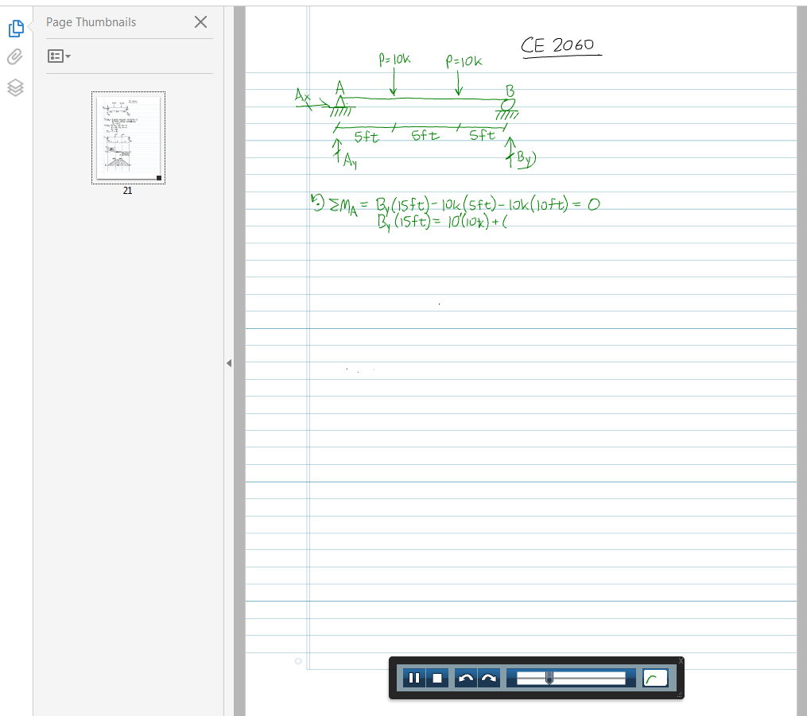

Slide 27
Pull out your PSS drafts and switch with a partner! Provide positive feedback, remember your Do’s and Don’ts!
Example Class Activity

Slide 28
Adaptation

Slide 29
Adaptation
Pro’s
Con’s
Learn about problem-solving process
Figure out tackling a common problem
Review course content
Hear yourself and know how you sound explaining material
Create useable materials for tutoring
Discuss difficult concepts in content groups
Unstructured creation of problem (training sessions have been updated)
Limited recording time (updated timeline)
Not as professional as Khan Academy or other online videos
Learning curve with technology

Slide 30
Work with a group to discuss how to implement this or a similar project at your institution.
Activity: Groupwork

Slide 31
Ideas

Slide 32
Future Work
Create a new How-To for tutors and student users
Create an easily navigated website with all uploaded files
Integrate the use of other technology to increase accessibility
Introduce a “Request Option” so that students can request subjects and tutors can be paid to create PSS videos.
Suggestions?

