Slide 1
Riding the Wave Together
Partnering for a new approach to requesting a tutor
Rachel Brunson
Assistant Director
Peer Learning
Kristen Norris
Assistant Director
Early Intervention
Student Success Center
University of South Carolina
sc.edu/success

Slide 2
Overview
The Student Success Center at UofSC
Past & Present
Course Assistance Request Process
Preliminary Requests/Results of our Pilot Semester

Slide 3
Our Center
Student Success Center
Peer Learning
Success Connect
(Early Alert/Intervention)
Course Specific Support (Tutoring, SI, Writing)
Out-to-Lunch
Pre-Calculus Review Summer Program
Peer Leadership
1st Year Student Outreach
Faculty Referral
1:1 Academic Skill Development & Financial Education (Consultations)
Academic & Financial Education Workshops
Success Partners
Transfer &
Special Student Populations
Residential Bridge Program
NSE
Sophomores
Transfers
Veterans
Success Starts Here

Slide 4
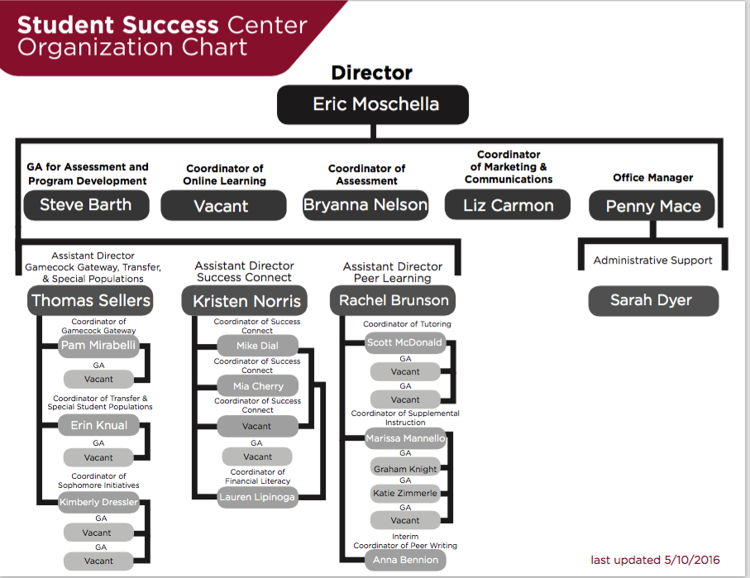

Slide 5
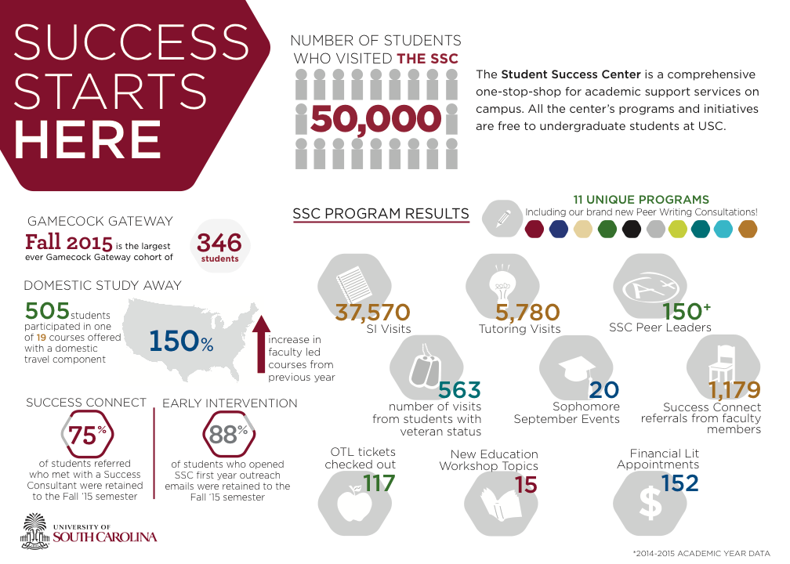

Slide 6

Peer Tutoring “At A Glance”
“…tailored to meet undergraduate students' individual questions and needs and to foster independent learning.”
  integration of content and skills
~60 Peer Tutors each semester
  undergraduate students
  support multiple courses
Tutoring is delivered in multiple formats
  1:1, drop-in, test reviews, and online
Notes:
-integrate content (“what”) and study skills (“how”)
-Tutors have excelled in course, apply, undergo group interview/individual interview, etc.
-Tutors typically support 4-5 hours, working approximately 10 hours each week

Slide 7
Peer Tutoring “At A Glance”
2015-2016 Student Success Center Usage Data: Peer Tutoring | Summer 2015 | Fall 2015 | Spring 2016 | 2015-2016
 | (June-July) | (Aug-Dec) | (Jan-May) | (June-May)
Tutoring (Drop In & 1:1) - Visits | 82 | 3260 | 2810 | 6152
Tutoring (Drop in & 1:1)- Students | 34 | 1169 | 857 | 1835
Online Tutoring - Visits | . | 318 | 112 | 430
Online Tutoring - Students | . | 245 | 87 | 318
# of Tutors | 4 | 50 | 52 | 71

Slide 8
Peer Tutoring “At A Glance”
Mean Grade comparisons based on frequency of visits to Tutoring (Fall 2014)
Fall | 1 Visit | 2-3 Visits | 4-6 Visits | 7-9 Visits | 10+ Visits
# of Students* | 495 | 381 | 102 | 39 | 27
Mean Grade | 2.58 | 2.60 | 2.61 | 2.32 | 3.13
*Not unique students; includes repeat visits for each course a student attended tutoring

Slide 9
DWF Rate comparisons based on
frequency of visits to Tutoring (Fall 2014)
Overall DWF Rate for Tutoring Participants: 12% (n=126/1044)
Overall DWF rate for Non Tutoring Participants: 14.7% (n=2973/ 20272)
Fall | 1 Visit | 2-3 Visits | 4-6 Visits | 7-9 Visits | 10+ Visits
# of Students* | 495 | 381 | 102 | 39 | 27
# of DWFs | 71 | 41 | 11 | 3 | 0
DWF Rate | 14.3% | 10.8% | 10.8% | 7.7% | 0%
*Not unique students; includes repeat visits for each course a student attended tutoring

Slide 10

Past Processes & Challenges

Slide 11
Success Consultation Services
1:1 Academic Skill Development
  Structured curriculum & learning outcomes
  Interactive with tangible take-aways
  Founded in Motivational Interviewing
All 1st year students assigned a Success Consultant
  Go to person for questions
  Assist with university navigation and transition
Success Consultations are available to any students

Slide 12
Bringing it Together – a new approach
Needs:
  A process for students to request support
  An opportunity for an intentional conversation with student about course progress and perceived need
Leveraged existing 1:1 consultation services

Slide 13
Course Assistance Request Process
Step 1 - View our current semester's Supported Course List
Step 2 - Make a Success Consultation appointment online or visit the Student Success Center Main Location
Step 3 - Meet 1:1 with a Success Consultant to discuss your course and academic needs
Step 4 - Receive a follow-up within 72 hours of your Success Consultation about next steps
  Based on your conversation with a Success Consultant, next steps will be developed during your consultation.

Slide 14
Success Consultation: Request a Tutor
Learning Outcomes
Consultation Outline
Students will…
Evaluate positive and negative academic habits
Evaluate study strategies and time dedicated to course
Identify course progress
Ariculate one new study strategy to apply to course
Habits for specific course
General study strategies inventory
Time management / study time
Syllabus Map
Summary of conversation
Plan for moving forward

Slide 15
Preliminary Results – Sp16
23 students requested support through CARP
19 were matched with a tutor
12 attended at least 1 tutoring appointment for the course they requested

Slide 16

Moving Forward
Creating a partnership with the student
Expectation of continued use of SSC services
  Considering partnering student with peer consultant for check-ins (if not a 1st year student)

