Slide 1
F
Using the Appreciative Advising Model for Study Strategies Coaching

Slide 2
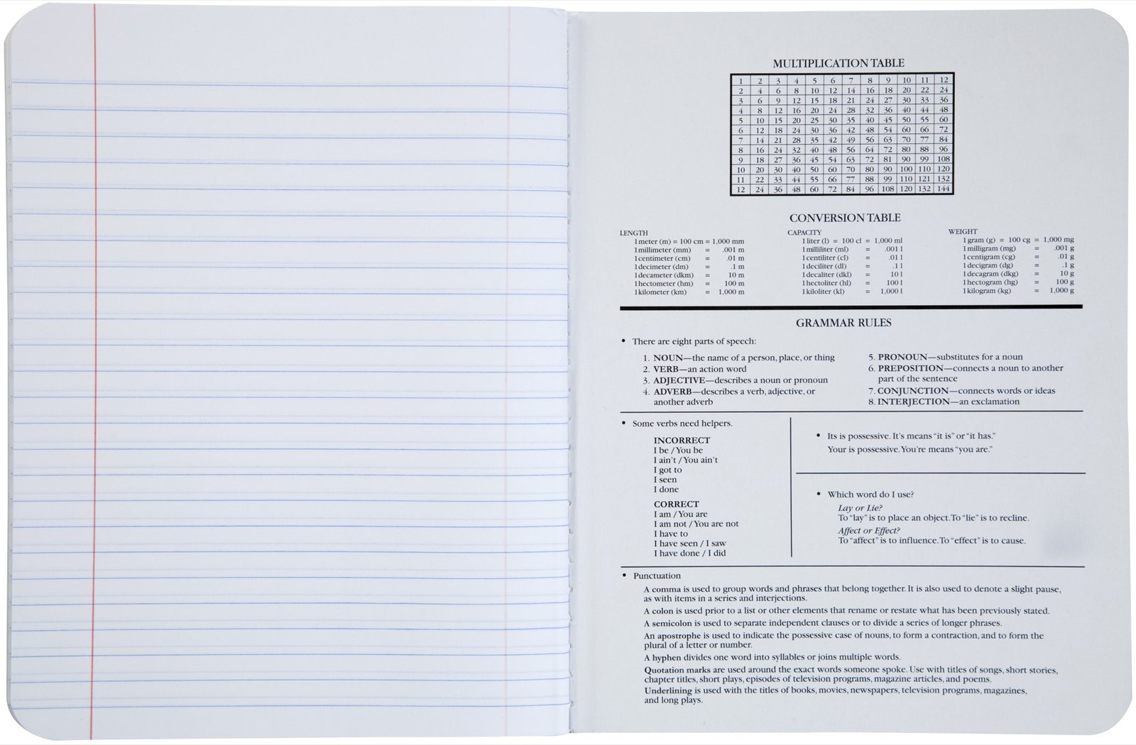
Using the Appreciative Education Framework for Study Strategies Coaching
Kaitlynn Kirk
College of Charleston
Center for Student Learning
Assistant Director
Notes:
Introduction:

Slide 3
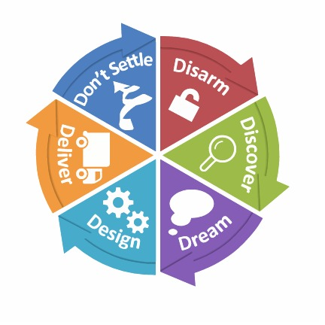
Goals
Discuss Academic Coaching and
Study Strategies Appointments
Walk through the 6 phases of Appreciative Advising
Discover the ways that academic coaching utilizes the Appreciative Advising framework

Slide 4
What is Academic Coaching?

Slide 5
Communication

Slide 6
DISARM
Get to know yourself first…
It starts from the beginning!
Making yourself available and easy to access
Safe Space to share and continue sharing throughout the semester

Slide 7
DISCOVER
Your students have unique
stories to tell, it’s your job
to uncover them!
What Energizes you? What drains you? What motivates you? What has been your best experience?
By focusing on the positives, we can discuss strategies to improve

Slide 8
DREAM
Vision for the Future
Parallel Plans
Own your dream; “homework” helps students take their life into their own hands
Magazine ?

Slide 9
DESIGN
Co-creating a Plan
Recognition of study
habits/ strengths/ strategies
Set and publicized deadlines for check-ins
Goals for the semester with check-ins at midterms
Resource List Effective Referrals

Slide 10
DELIVER
Written plans that are
publically acknowledged
by both parties
Recognizing obstacles and planning strategies to overcome those
Provide praise for positive actions throughout the semester (baby steps are better than no steps at all)
Midterm check-Ins

Slide 11
DON’T SETTLE
Find the happy spot to set the expectation bar for each
individual student
Jim Collins: good is the enemy of great
Becoming a pocket of greatness for your students to rely on
You did great, but what is one thing you can do better?

Slide 12
Questions???
Thank you for coming!
Please feel free to contact me with any further questions or concerns
kirkkj@cofc.edu

